Slide 1
Effect of Defects and Strain Rate on Graphene Sheet subjected to isothermal uniaxial tension
Prepared by: Anubhav Roy The University of Alabama

Slide 2
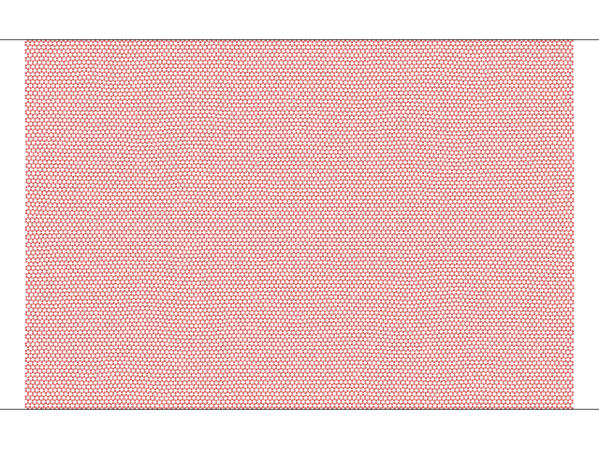
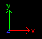
Pristine Sheet Details
Zigzag Orientation
Width = 30 nm
Length = 20 nm
No. of atoms : 23,616
Temperature : 300 K
UNIVERSITY OF ALABAMA

Slide 3
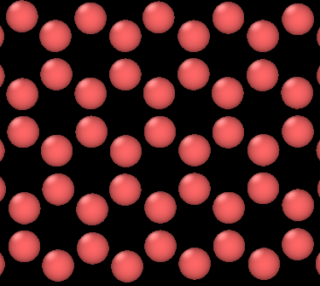
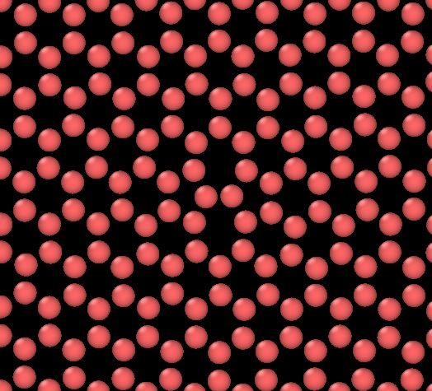
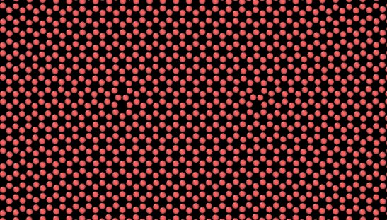
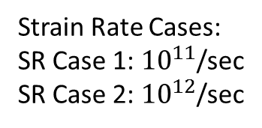
Studies of different cases with Stone-Wales Defect and Strain Rates
D Case 1
D Case 2
D Case 3
Pristine
Single Defect
Multi-Defect
b = 10 a
Strain Rate Cases:
SR Case 1: ${10}^{11}$/sec
SR Case 2: ${10}^{12}$/sec
‘a’ = Lattice Parameter = 0.25 nm
UNIVERSITY OF ALABAMA

Slide 4
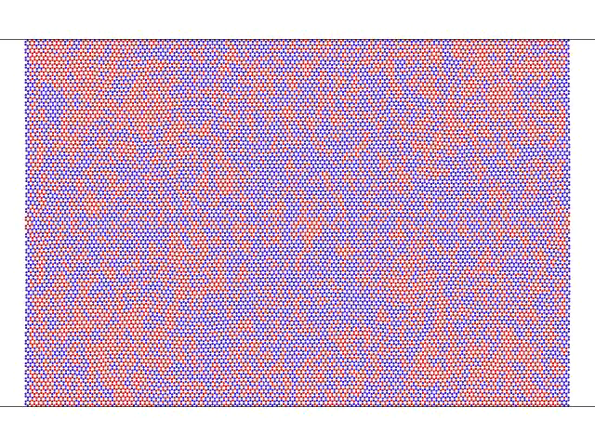
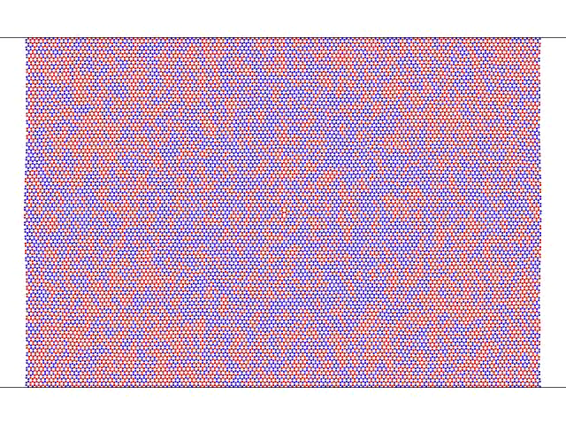
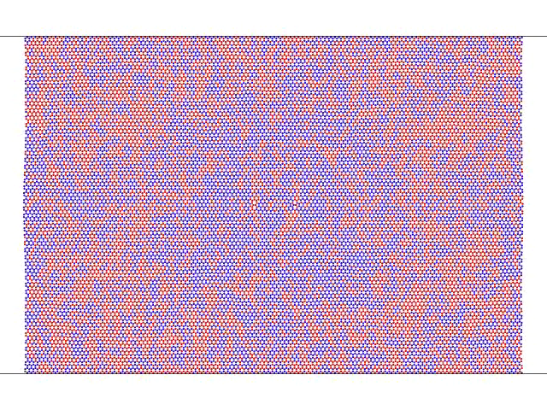
Sample Simulations for SR Case 2
Single-Defect D-case 2
Pristine D-case 1
Multi-Defect D case 3
UNIVERSITY OF ALABAMA

Slide 5
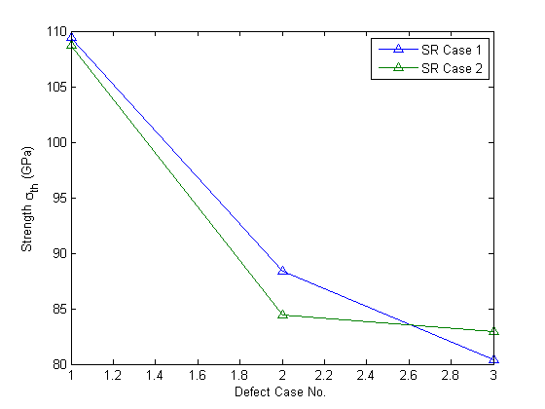
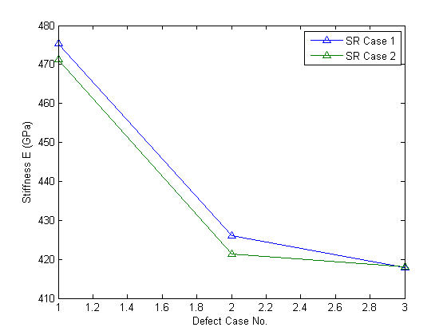
2-D representations
Pristine → Multi-Defect
UNIVERSITY OF ALABAMA

Slide 6
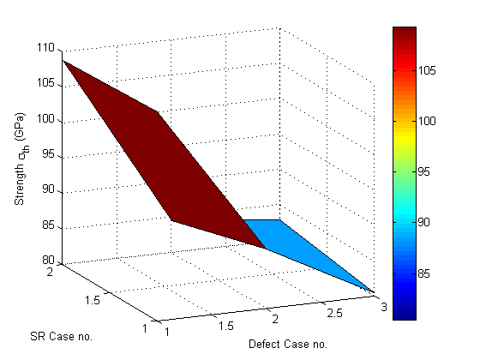
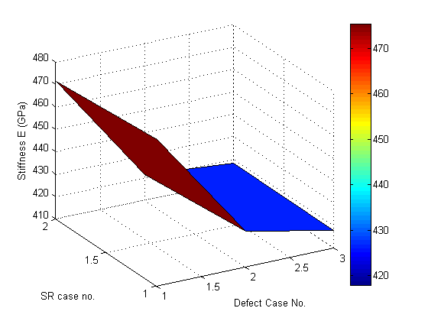
3-D representations
Pristine → Multi-Defect
UNIVERSITY OF ALABAMA

Slide 7
Work Underway
Simulations for higher strain rates ${10}^{13} \& {10}^{14}$ are running…
UNIVERSITY OF ALABAMA

Slide 8
Thank You
UNIVERSITY OF ALABAMA

